Slide 1


ReportAm
Making Oyo better - Team Nova

Slide 2
Community challenges .
Problems in Oyo:
Community issues in Oyo go untracked.
Complaints are scattered across social media, with even less members of the state being technologically literate.
No centralized reporting system or enforced accountability platform.
No transparency on resolution
For such an integrated society, oyo faces certain community challenges that although not unique to it remains bothersome

Slide 3
Proposed Solution:
A web platform that allows residents to:
• Report issues with photos
• Capture location automatically
• Categorize problems
• Track status publicly
Ensuring accountability, traceability and transparency

Slide 4
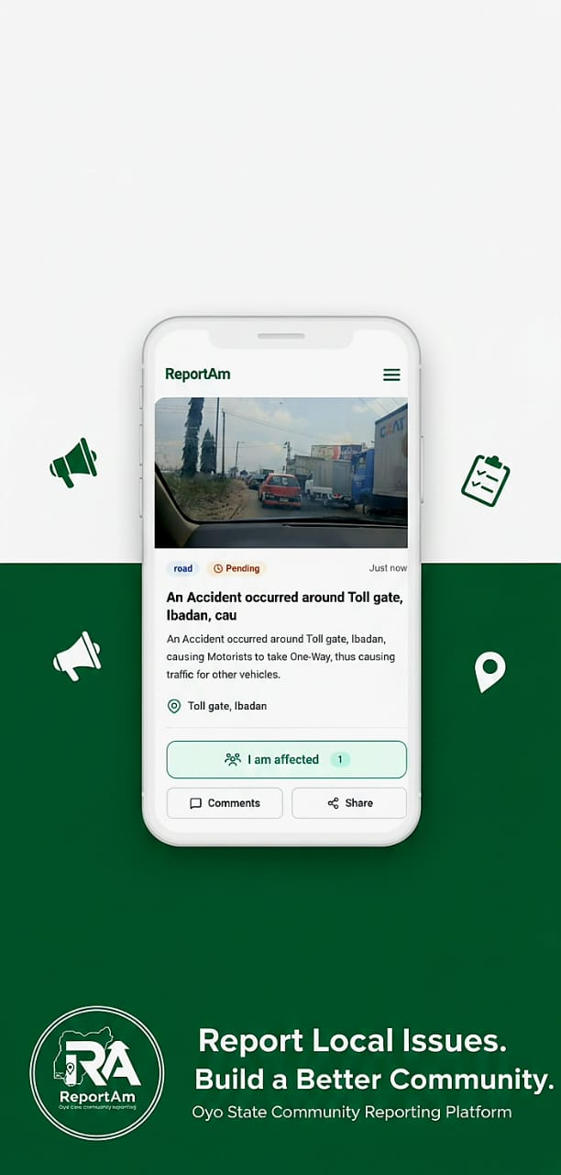
What is ReportAm?
ReportAm is a community-driven web app designed to empower residents in Oyo to report issues affecting their neighborhoods. Users can easily upload photos, pinpoint locations, and categorize problems, facilitating transparent tracking and resolution of community concerns for effective civic engagement.

Slide 5
Core User Flow
Open ReportAm
Click Report
Users start by launching the ReportAm app.
They select either Issue or Emergency to proceed.
Upload Photo
Location Captured
Users can easily upload a relevant photo here.
The app automatically captures the user's location.

Slide 6
Core User Flow Continued
Select Category
Explain Briefly
Submit
Users choose specific issue type for reporting.
A short description of the problem is added.
Finalize the report for community visibility.
Report Appears
Community Engagement
The issue is visible on the public feed.
Residents can engage and track the reports.

Slide 7
Report Tracking
EFFICIENT MANAGEMENT OF COMMUNITY ISSUES
Community Engagement
Admin Control
Transparency
Admins have the ability to mark reports as pending or resolved, ensuring that community members are informed of the current status of issues and actions taken.
Users can express their concerns by tapping 'I’m affected,' fostering a sense of community and encouraging collective action towards resolving the reported problems in Oyo.
By displaying all reports publicly, the platform ensures that everyone can see and track ongoing issues, promoting accountability and collaboration among residents and local authorities.

Slide 8
Report Categories
Road
Waste
Drainage
Report issues related to damaged or unsafe roads.
Highlight the need for better waste management practices.
Address problems caused by poor drainage systems.
Electricity
Emergency
Fights
Report outages and electrical infrastructure concerns.
Urgent reports for immediate community safety issues.
Notify about disturbances or violent confrontations happening.

Slide 9
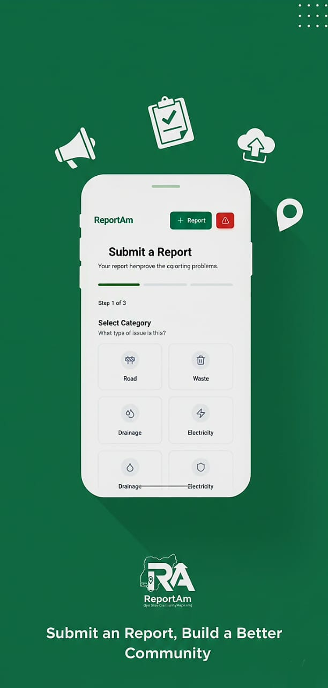
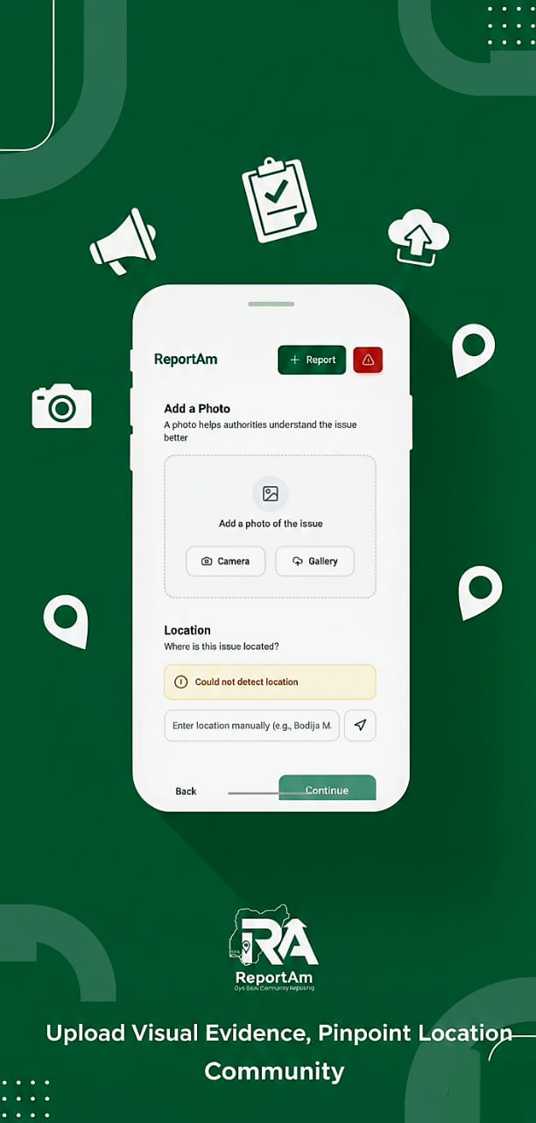
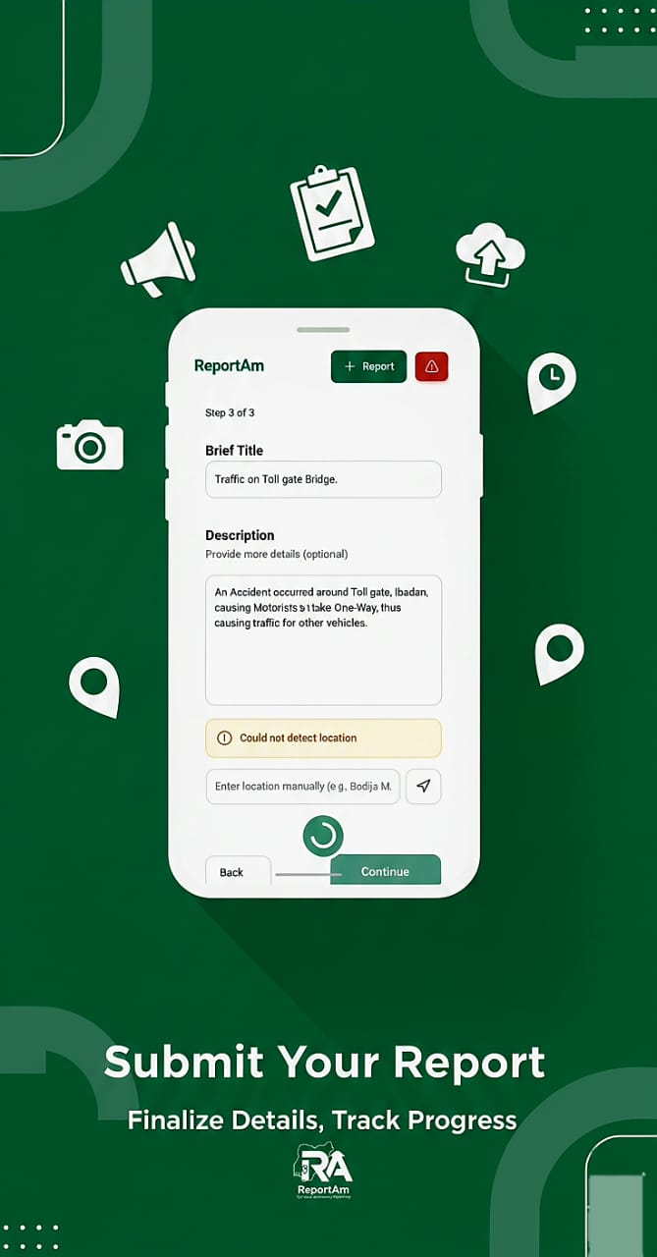
Report Screen Mockups

Slide 10
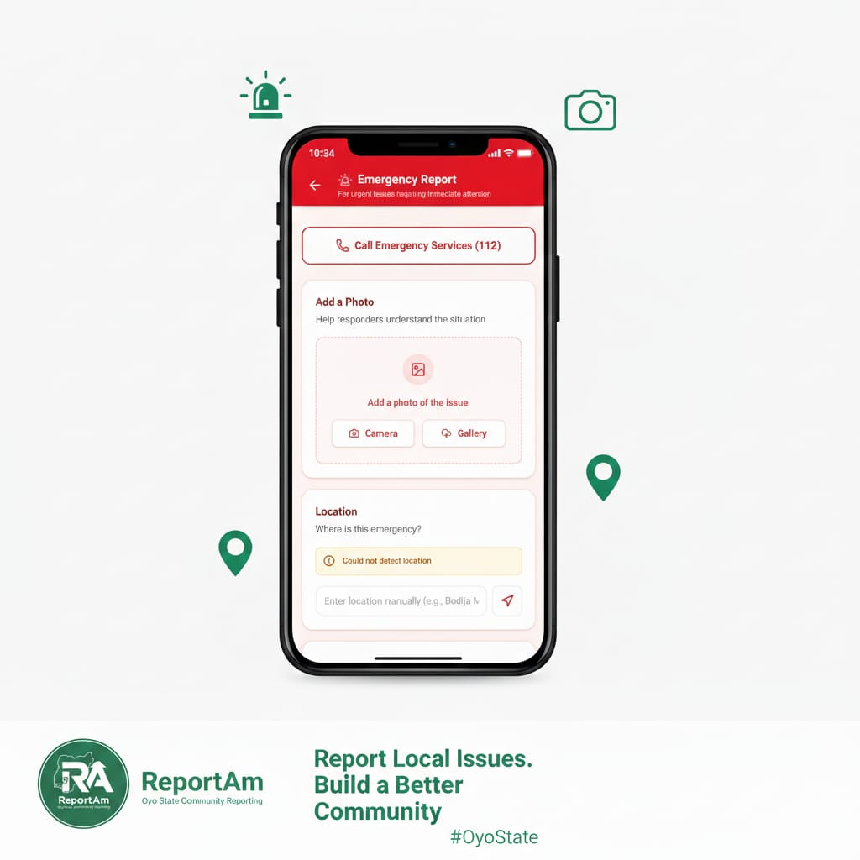
Thanks for Watching
TEAM NOVA

